Slide 1
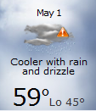
HRNEWS
Bringing the Amazon to your front door since April 26, 2012!

Slide 2


